Slide 1
MediaEval'20 Multimedia Evaluation Workshop, Dec 14&15, 2020
Efficient Supervision Net: Polyp Segmentation using Efficient net and Attention unit
Paper ID : 72
Author by
Sabarinathan, R.Suganya

Slide 2
Abstract
Colorectal cancer is the third most common cause of cancer worldwide. In the era of medical Industry, identifying colorectal cancer in its early stages has been a challenging problem.
The risk of colorectal cancer could be reduced by early diagnosis of poly during a colonoscopy.
The disease and their symptoms are highly varying and always a need for a continuous update of knowledge for the doctors and medical analyst
Inspired by these issues, the main objective of this paper is to develop a Multi supervision net algorithm for segmenting polys on a comprehensive dataset.
Machine Learning algorithms help us achieve this objective. Regression models are one of the most powerful supervised machine learning techniques to classify large-scale data.
We proposed an efficient Net B4 as a pre-trained architecture in multi-supervision net. The model is trained with multiple output layers. We present quantitative results on colorectal dataset to evaluate the performance and achieved good results in all the performance metrics.

Slide 3
Objective and Goals
The main objective of this work:
Created a novel Multi-Supervision Net architecture is proposed. Ie., The model is trained with multiple output layer.
Evaluated of the proposed architecture on challenging Polyps segmentation data set
Used Efficient NetB4 as a backbone for the proposed architecture
Achieved good experimental results in terms of accuracy, F1 score and loss..

Slide 4
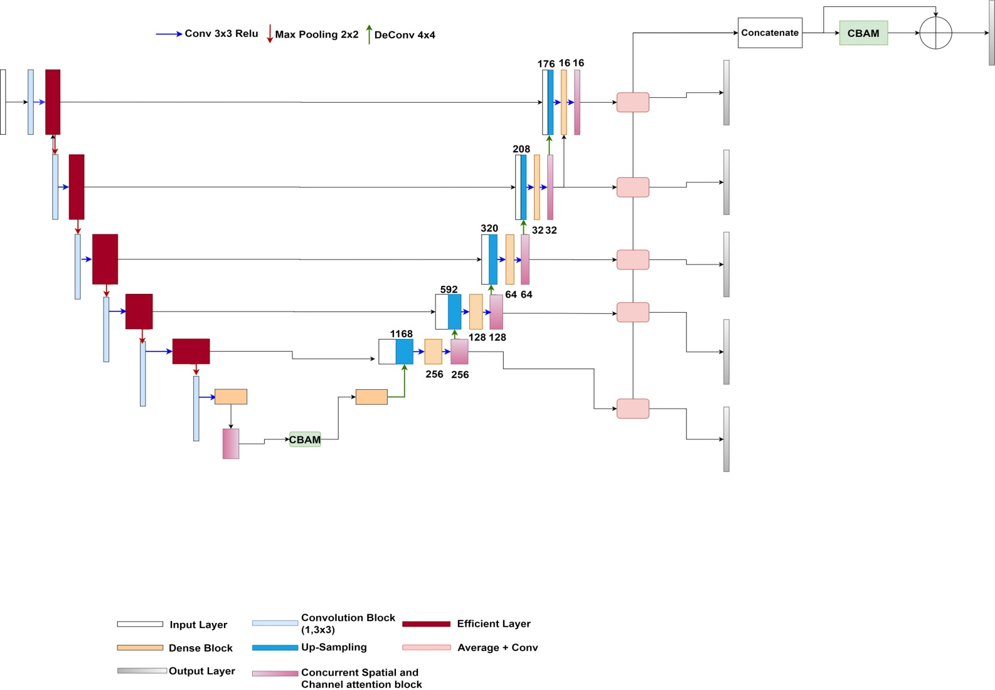
Proposed Methodology:Multi supervision Net

Slide 5
Multi supervision Net
Our proposed method for polyp segmentation uses a deep convolutional network to learn a connection between the input polyps’ images.
The overall block diagram of the proposed architecture consist of a five layers
(1) Convolutional layer,
(2) Efficient layer
(3) Encoder block with efficient Net B4
(4) Decoder block –combination of dense block and Concurrent Spatial and Channel Attention blocks
(5) Convolution Block Attention Module (CBAM).
In this architecture, the input image pixels 332 X 487 is resized to 384 X 256 and divided by 255 are passed in to the convolutional layer.

Slide 6
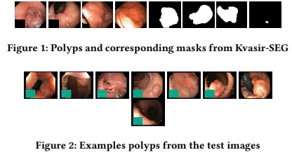
Dataset
The Kvaris-SEGtraining dataset can be downloaded from https://datasets.simula.no/kvasir-seg .
It contains 1,000 polyp images and their corresponding ground truth mask
The dataset was collected from real routine clinical examinations at Baerum Hospital in Norway by expert gastroenterologists.
The resolution of images varies from 332 X 487 to 1920 X 1072 pixels.

Slide 7
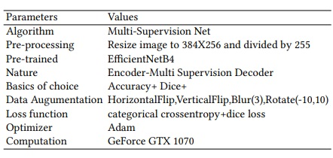
Implementation details

Slide 8
Experimental results
Evaluation Parameters | Results
Jaccard | 0.777331872
DSC | 0.850309787
Recall | 0.916460577
Precision | 0.83897232
Accuracy | 0.95668669
F2 | 0.879019208

Slide 9
Conclusion
We have presented a novel and unique Multi-supervision Net with Efficient Net B4 as the backbone of the architecture to improve the accuracy of segmentation image under different factors.
We accomplished this by training a multilevel attention network to take images from Medico challenge 2020- polyp segmentation dataset.
Moreover, we present Concurrent spatial and channel attention block in decoder to improve the quality of image.
As a major contribution, CBAM is added to improve the overall mechanism and also utilizes the significant features from the Encoder block.

Slide 10
References
D.Sabarinathan, M.Parisa Beham, and S.M.Md.Mansoor Roomi. 2019. Hyper Vision Net: Kidney Tumor Segmentation Using Coordinate Convolutional Layer and Attention Unit. arXiv preprint arXiv:1908.03339.
Gao Huang, Zhuang Liu, Laurens van der Maaten, and Kilian Q. Weinberger. 2017. Densely Connected Convolutional Networks. arXiv:1608.06993.
Debesh Jha, Pia H Smedsrud, Michael A Riegler, Pål Halvorsen, Thomas de Lange, Dag Johansen, and Håvard D Johansen. 2020. Kvasir-SEG: A segmented polyp dataset. In Proc. of International Conference on Multimedia Modeling. 451–462.
Abhijit Guha Roy, Nassir Navab, and Christian Wachinger. 2018. Concurrent Spatial and Channel Squeeze Excitation in Fully convolutional Networks. arXiv:1803.02579.
Mingxing Tan and Quoc V. 2019. EfficientNet: Rethinking Model Scaling for Convolutional Neural Networks. arXiv:1905.11946.
Woo and Sanghyun. 2018. CBAM: Convolutional block attention module. In Proceedings of the European Conference on Computer Vision (ECCV)

Slide 11
THANK YOU..!!!

